Slide 1

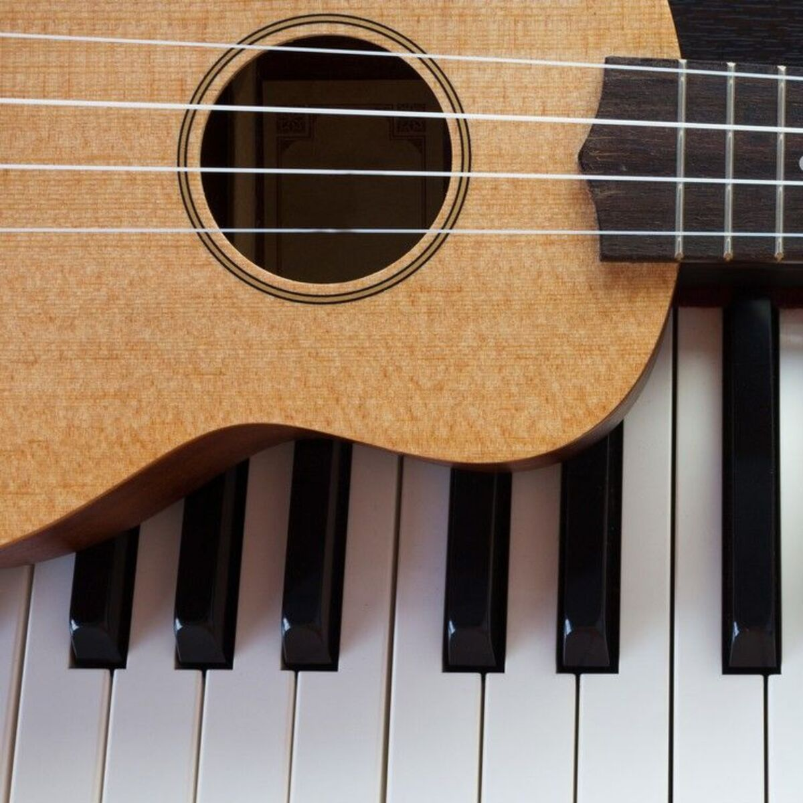
Chord Classifier
Daniel gilkarov 325010288

Slide 2
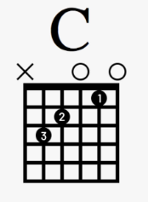
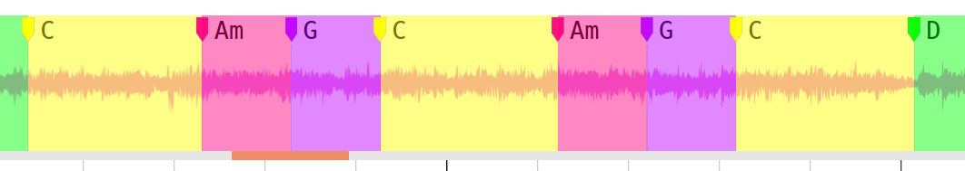
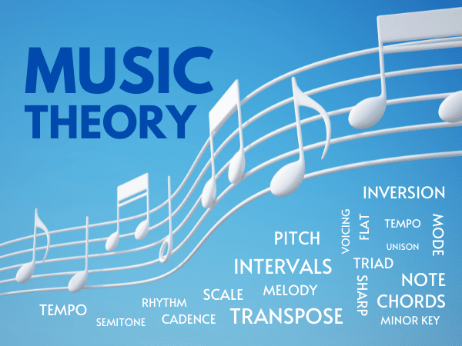
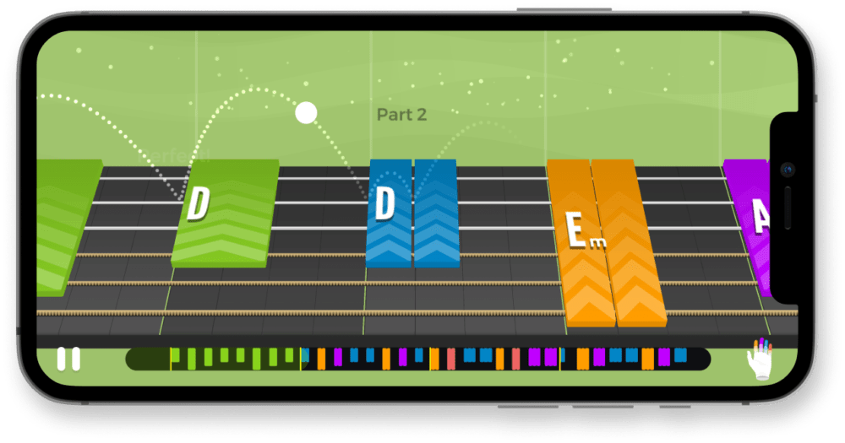
INTRODUCTION
Chord Classification is the task of labeling an input audio recording with a certain chord label
Automatic Chord Recognition is a close relative to Chord classification where an audio is segmented into 1 or more chords
Chord classification is useful for:
Music Teaching apps
Musical Analysis

Slide 3
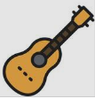
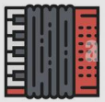
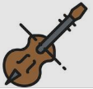
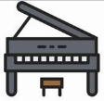

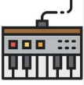
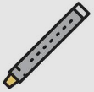



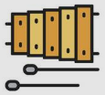


DATASETS
Training dataset
Osmalsky - Guitar, Accordion, Violin, Piano chord recordings dataset by Julien Osmalskyj
Test datasets
IDMT-SMT-CHORDS – dataset of MIDI-generated audio of guitar, keyboard chords
Multinstrument - Custom Dataset created by me used for proving robustness of model

Slide 4
DATASETS - STATISTICS
DATASET | #Samples per Instrument Ratio | General Properties
Training data: OSMALSKY |  | Real instruments Anechoic/Noisy Environment Different play styles (arpege, staccato, legato, etc.)
IDMT-SMT-CHORDS |  | Computer generated One chord per instrument preset 6 Guitar presets 10 Piano/Keyboard presets Ableton/Garageband
MULTINSTRUMENT | 10 samples for every instrument | Real instrument excerpts One chord per instrument 8 Different instruments brass/wind/bell type
Global Dataset properties
2-second-long samples
44.1KHZ Sampling rate
16-bit stream
WAV file format

